Slide 1
Week 6 Slides

Slide 2
Agenda
Recursion
Java Revision

Slide 3
Fibonacci Sequence
0, 1, 1, 2, 3, 5, 8, 13, 21, ….
Any term is the sum of its previous two terms

Slide 4
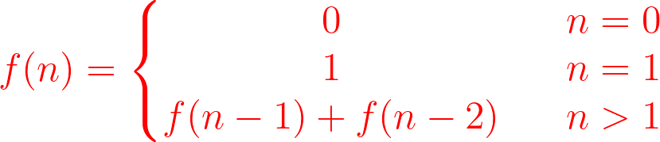
Recursive Fibonacci Definition
Base Cases
Recursive Definition

Slide 5
Calls to smaller problems are repeated
f(5)
f(4)
f(3)
f(3)
f(2)
f(2)
f(1)
f(2)
f(1)
f(1)
f(0)
f(1)
f(0)
f(1)
f(0)

Slide 6
Solution - Store the results of subproblems in an array (top down solution)
Initialize array[] as {0, 1, 0, 0, 0, 0}
Define f(n):
if n is 0 or 1, return array[n] base case
else if array[n] is not 0, return array[n] solution has been calculated
else array[n] = f(n-1) + f(n-2) solution has not been calculated
return array[n]

Slide 7
Solution – Iterate from the array (bottom-up solution)
Initialize array[] as {0, 1, 0, 0, 0, 0}
Repeat from i = 2 to target n:
array[i] = array[i-1]+array[i-2]

Slide 8
Java Revision
Without executing the code, what will you see on the screen?
int a[] = {1,2,3,4,5}; int i = 0; a[i++] += 4; System.out.println(Arrays.toString(a)); a[i] += 9; System.out.println(Arrays.toString(a));

Slide 9
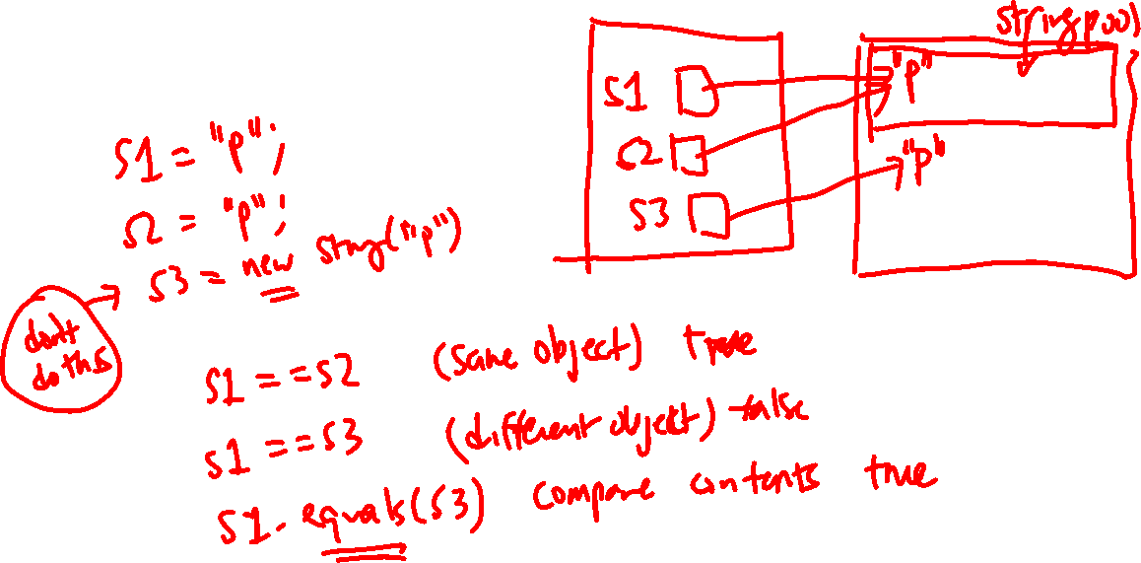

Slide 10
